Slide 1
Recitation #3
17-356/17-766

Slide 2
TAs
Mehul Agarwal
email: mehula@andrew.cmu.edu
office hours: TBD
Rohit Shreenivas
email: rshreeni@andrew.cmu.edu
office hours: TBD

Slide 3
Full-stack Development
Different levels of the stack:
Backend
Frontend
Database
Deployment
Testing
and more
Today’s topic

Slide 4
Frontend
What the user sees + interacts with
“Client-side code”
Probably know of HTML/CSS/JS, you can build vanilla frontends with them
Today we will learn React (https://reactjs.org)

Slide 5
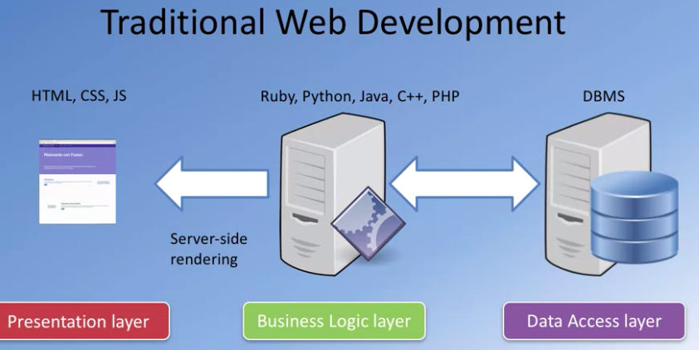

Slide 6
Styling and CSS
We don’t have a dedicated recitation for styling, because there are so many many systems you can follow.
Google is your friend.
Course's personal pick: Flexbox https://developer.mozilla.org/en-US/docs/Learn/CSS/CSS_layout/Flexbox
https://www.youtube.com/watch?v=JJSoEo8JSnc

Slide 7
FRONTEND DEVELOPMENT USING REACT.JS

Slide 8
React
Created 2011 (by Facebook)
“Frontend JS Library” (technically not a framework, but its chill)
Declarative, Component-Based
Uses JSX syntax (HTML inside your JS)

Slide 9
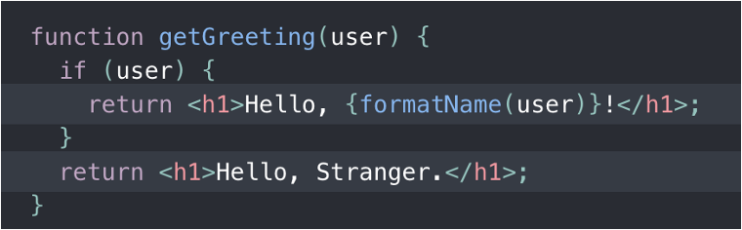

This funny tag syntax is neither a string nor HTML.

Slide 10
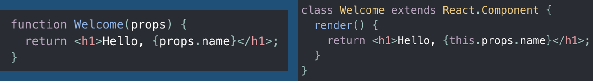
Components
“React Only Updates What’s Necessary”
2 Ways: Functions and Class components
You can nest components

Slide 11
Props
Props are similar to function parameters
Props are read-only. Most important rule in React: “All React components must act like pure functions with respect to their props.”
React components use props to communicate with each other. Every parent component can pass some information to its child components by giving them props.

Slide 12
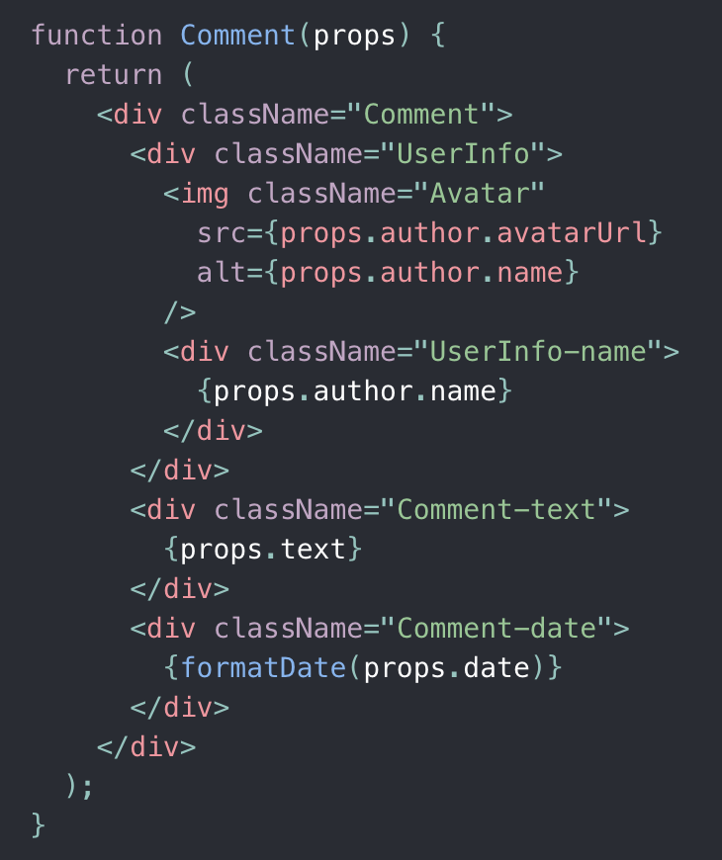

Slide 13
States and Lifecycle
Component State = saved (and usually important) information about a component
Changing state -> trigger a component reload
Do not modify state directly (will not trigger reload). Use React’s state funcs(setState()).
componentWillMount() and componentWillUnmount() are used to identify the lifecycle of a component

Slide 14
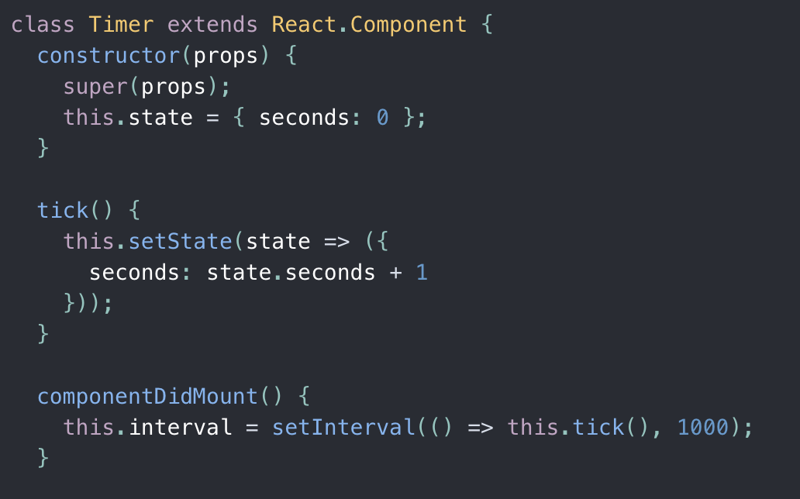
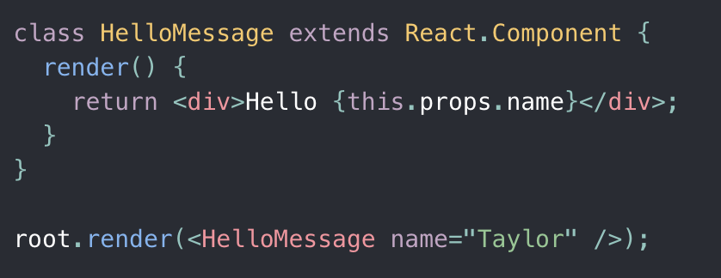
A simple React Component
A stateful React Component

Slide 15
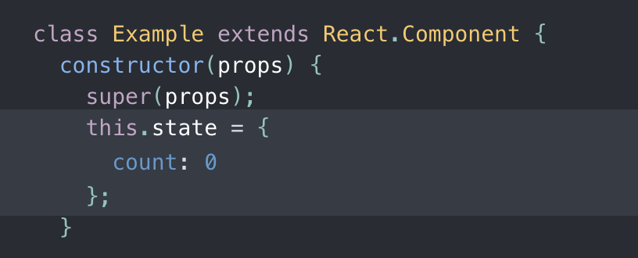
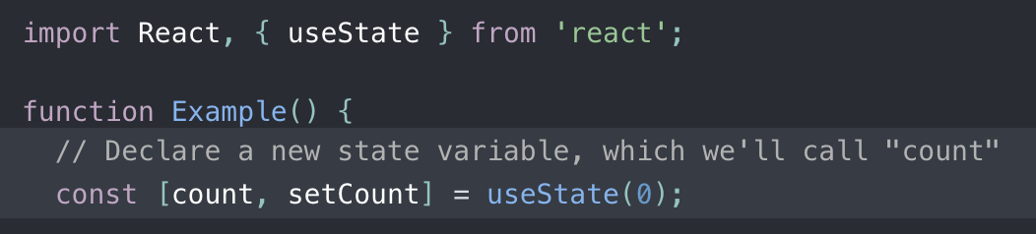
Hooks: Worth looking into
Notes:
Hooks are a new addition in React 16.8. They let you use state and other React features without writing a class.

Slide 16
Data (States & Props) Flow
Parent-Child relationships (think Tree)
State is always local, but can flow downwards (to children) as props.
Common Workaround: pass a state-modifying function as prop to child.
Child can then call the passed function to indirectly modify parent state.

Slide 17
How to think + code like a React dev
Break UI into component list/hierarchy (form the Tree)
Build static version of UI first
Compatible with data models, but no interactions
Find simplest representation of UI state for each component
Identify where state should live
Add inverse data flow (changes go back up)

Slide 18
Component Libraries/Frameworks
SUPER USEFUL (and fun to explore)
You no longer have to style everything by hand
Find one that you enjoy and read the docs on how to use it!
Popular ones: MaterialUI (google), Bootstrap, Ant Design (Ant Financial, Alibaba), Evergreen
We’re gonna use Geist UI (more obscure, to get used to learning weird things)

Slide 19
React demo app
node -v
mkdir <project-name> and cd into it
npx create-react-app .
sudo npm install --global yarn
yarn add @geist-ui/react
https://github.com/CMU-17-356/cmu-17-356.github.io/tree/main/resources/recitations/2021/Recitation%203/todo-app-rec3/todo-app-frontend

